Slide 1
The Seven Churches of Revelation: “Ephesus – Find Your First Love… Again”
Part of a study of the Book of Revelation chapters 2 & 3 in which Jesus writes to the Seven Churches in the Province of Asia (now Western Turkey).
By Andy Acreman, Thurrock Christian Fellowship
12th May 2024

Slide 2
Points to Cover…
Setting the scene: Revelation, John, When and Where?
Then Jesus appears! Symbolism of His appearance
Geography of the Seven Churches
Ephesus: its geography, background, and culture
What does Jesus know about them?
What does Jesus commend and criticise?
What promises and warnings does He give them?
How does all this apply to us in TCF today?

Slide 3
Read Revelation Chapter 1 (all) 1,4-6…
The revelation from Jesus Christ, which God gave him to show his servants what must soon take place. He made it known by sending his angel to his servant John,…
⁴ John, To the seven churches in the province of Asia: Grace and peace to you from him who is, and who was, and who is to come, and from the seven spirits before his throne, ⁵ and from Jesus Christ, who is the faithful witness, the firstborn from the dead, and the ruler of the kings of the earth. To him who loves us and has freed us from our sins by his blood, ⁶ and has made us to be a kingdom and priests to serve his God and Father-to him be glory and power for ever and ever! Amen…
⁹ I, John, your brother and companion in the suffering and kingdom and patient endurance that are ours in Jesus, was on the island of Patmos because of the word of God and the testimony of Jesus. ¹⁰ On the Lord's Day I was in the Spirit, and I heard behind me a loud voice like a trumpet, ¹¹ which said: "Write on a scroll what you see and send it to the seven churches: to Ephesus, Smyrna, Pergamum, Thyatira, Sardis, Philadelphia and Laodicea."
Notes:
From Jesus to his angel to John to the churches (and to us!)
Descriptions of God the Father, God the Holy Spirit, and God the Son
Written by the Apostle John in around 95 AD from his place of exile on the island of Patmos – a small island penal colony just off the coast of Turkey, where he had been sent for refusing to worship the Emperor Diocletian. This was geographically quite close to those seven churches.
The day that John had received all these visions is called ‘The Lord’s Day’ in 1:10, but should maybe more correctly be called ‘Emperor’s Day’, the first day of each month devoted to ceremonial worship of the Roman emperor, and the requirement to call him ‘Lord’ or ‘Son of God’. In the New Testament, the phrase “The Lord’s Day” is never used of a Sunday; in the Old Testament, the nearest term would be “The Day of the Lord”, but that cannot be what John was referring to. So it was ‘Emperor’s Day’ when these visions occurred.
John was suffering for his failure to bow down and to burn incense to the emperor, so it is highly significant that the true Lord, and King of Kings, would reveal himself to John as a direct challenge to that human counterfeit!
These Seven Churches were actual local congregations but are understood to be symbolic of the whole Bride of Christ – therefore including us today – and Jesus the Bridegroom is speaking to us all about matters of eternal importance!
What was sent to each church (v11) was not only the letter to that church, but the entire Book of Revelation!

Slide 4
Read Revelation Chapter 1 (all) …9-20
¹² I turned around to see the voice that was speaking to me. And when I turned, I saw seven golden lampstands, ¹³ and among the lampstands was someone like a son of man, dressed in a robe reaching down to his feet and with a golden sash around his chest. ¹⁴ The hair on his head was white like wool, as white as snow, and his eyes were like blazing fire. ¹⁵ His feet were like bronze glowing in a furnace, and his voice was like the sound of rushing waters. ¹⁶ In his right hand he held seven stars, and coming out of his mouth was a sharp, double-edged sword. His face was like the sun shining in all its brilliance. ¹⁷ When I saw him, I fell at his feet as though dead. Then he placed his right hand on me and said: "Do not be afraid. I am the First and the Last. ¹⁸ I am the Living One; I was dead, and now look, I am alive for ever and ever! And I hold the keys of death and Hades. ¹⁹ "Write, therefore, what you have seen, what is now and what will take place later. ²⁰ The mystery of the seven stars that you saw in my right hand and of the seven golden lampstands is this: The seven stars are the angels of the seven churches, and the seven lampstands are the seven churches.
Notes:
If you painted a picture of Jesus looking like this, it would look grotesque! But each symbol has its own meaning; we have a prophetic picture of Jesus being painted here that describes his character, his power, his holiness and his majesty.
Verse 20 interprets the seven stars and the seven lampstands for us: The lampstands – or menorah – were like the seven-lamped golden lampstand found in the Holy Place of the temple – which was the only place it was allowed to be used. They represent local churches. As churches, we are the light of the world – shining with the glory of He who is the world’s light.
The stars represent the guardian or messenger angel that belongs to each local church. Stars usually represent heavenly beings, and these are designated to guard the Bride on behalf of the heavenly Bridegroom.
Each of the seven letters to each church contains some of the symbolism of Jesus – chosen specifically for that particular church’s needs. (I wonder what TCF’s symbols would be ?).
Each person teaching on a particular letter to a church will explain what the designated symbol represents in their case.

Slide 5
Modern Turkey (1000 miles x 400 miles)…
Notes:
Turkey is a large country, about three times the land area of the UK. The bridge between Europe and Asia. It used to be called ‘Asia Minor’.
Circled is the region in the west that held the seven churches of Revelation.

Slide 6
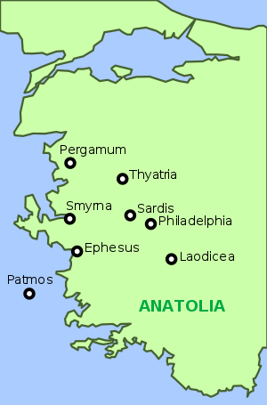
Geography of the Seven Churches…
Ephesus (now a monument)
Smyrna (now Izmir)
Pergamum (no longer exists)
Thyatira (now Akhisar)
Sardis (no longer exists)
Philadelphia (now Alasehir)
Laodicea (now Denizli)
See also Island of Patmos
Notes:
Geographically, this was known as the ‘Province of Asia’ in Roman times.
In those days, these seven towns were on an official mail route – which is probably why Jesus listed them in the biblical sequence. After all, a set of letters was being sent from Him!
The ancient towns and churches are geographically clockwise, starting with Ephesus.
Some of these towns still exist – with modern names – whilst others have ceased to exist at all.
Since the beginning of 20th Century, none of these named churches exist any more. An the Christian population of Turkey is very small indeed.
The Island of Patmos, where John was exiled, was small (13 square miles) and just off the coast of Turkey.

Slide 7
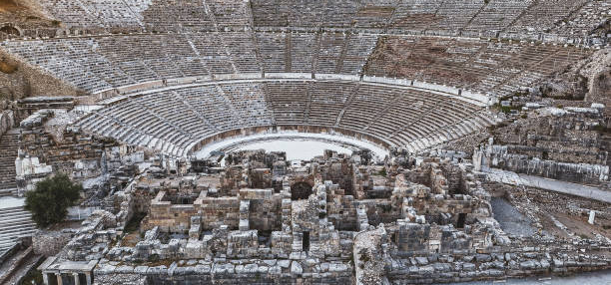
The Ancient City of Ephesus…
Notes:
I have walked around the ruins of ancient Ephesus, which has some of the best-preserved Greek and Roman artifacts.
This is the amphitheatre where the riot in Acts 19 occurred. The acoustics are amazing even today!

Slide 8
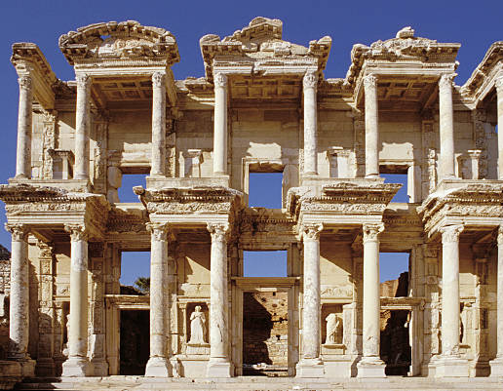
The Ancient City of Ephesus…
Library of Celsus (ruins)
Temple of Artemis (impression)
Notes:
Paul founded the Ephesian church (Acts 18:19-20; Acts 19). He first evangelised the Jews there for three months and then taught the Gentiles for two years in the lecture hall of Tyrannus. He performed extraordinary miracles there and many exorcisms.
It was the centre of Artemis worship. A Greek deity, she was the goddess of hunting, chastity, childbirth, wild animals and the wilderness. (‘Diana’ in Roman mythology).
The Temple to Artemis (350 BC) was huge – four times larger than the Parthenon in Athens, and one of the seven wonders of the world.
In Roman times, Ephesus was a thriving port city, and culturally second only to Rome. Population 250,000.
Paul’s ministry created a huge church – at one point nearly half that population! The largest in the world.
Paul’s letters to the Ephesians, and to Timothy who led it, are therefore very important.
But now, we are another 30-40 years on, and the Apostle John has made Ephesus his missionary base. This is now the situation where the letter in Revelation is being written.

Slide 9
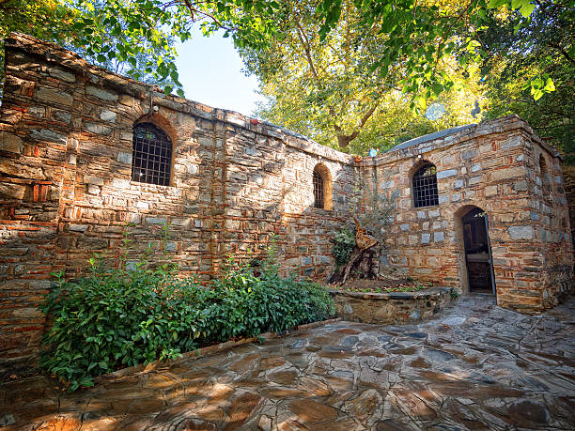
The Ancient City of Ephesus…
House of Virgin Mary
Highway of the Martyrs
Notes:
Tradition holds that when the Apostle John moved his centre of operations to Ephesus, he took Jesus’ mother, Mary, there too – since he had promised to take care of her. This is allegedly her residence. Of course, in later centuries it became a shrine of pilgrimage too!
Ephesus, in Roman times, was on the great highway from Asia to Europe and ultimately by sea to Rome. This was a time of great persecution of the church under the Roman emperors and so huge number of Christians were taken in chains to Rome to provide deadly entertainment for its citizens in the Coliseum. In the picture we see part of that great road that later became known as the ‘Highway of the Martyrs’ for that reason!

Slide 10
Revelation Chapter 2:1-7
To the angel of the church in Ephesus write: These are the words of him who holds the seven stars in his right hand and walks among the seven golden lampstands. ² I know your deeds, your hard work and your perseverance. I know that you cannot tolerate wicked people, that you have tested those who claim to be apostles but are not, and have found them false. ³ You have persevered and have endured hardships for my name and have not grown weary. ⁴ Yet I hold this against you: You have forsaken the love you had at first. ⁵ Consider how far you have fallen! Repent and do the things you did at first. If you do not repent, I will come to you and remove your lampstand from its place. ⁶ But you have this in your favour: You hate the practices of the Nicolaitans, which I also hate. ⁷ Whoever has ears, let them hear what the Spirit says to the churches. To the one who is victorious, I will give the right to eat from the tree of life, which is in the paradise of God.
Notes:
These letters are all written to ‘The Angel of the Church…’ and I think it is a spiritual thing. Church members and church leaders come and go, but the angelic guardian (or guardians) of a local church are there for the entire duration of its existence. It may also signify the church members seated in the Heavenly Realms with Christ. This was to be a timeless message.
We already know that the seven stars represent all those angels of all those churches – the heavenly bride. Jesus, the future Bridegroom, holds these stars, His Bride firmly and securely. The seven lampstands represent the seven churches on the ground. They were placed on the earth to be a light to the world around them.
Highlighted in light blue are the many ways that Jesus commends and applauds the Ephesian church. It was highly regarded and admired by all the respected Christians in the region and was clearly a role model of faith, endurance, correct theology, and spiritual discernment for others to emulate. There was a letter to the Ephesians written by Ignatius – a ‘church father’ – which underlined and commended exactly the same good things that Jesus has here – but in different words, and therefore independently. This was a great church to be associated with, and a great leader in its region.
Hard working Christians who complete the tasks they have been given. Discerning leaders who guard the flock from spiritual ‘wolves’. There were clearly genuine apostles practising their ministry – long after the Twelve that Jesus trained – and Ephesians 4 tells us that apostles are enduring ministries throughout the church age. Otherwise, what would be the point of ‘testing’ them if no-one could be an apostle! But wisely, the false ones were rejected. Well done!
The church members persevered through great hardships, persecutions, and martyrdoms for the sake of Jesus, and did not ever grow tired of doing good things to advance the Kingdom. Those two years of daily teaching that Paul had deposited with them so many years previously had not been lost or forgotten. This church was doctrinally pure! The Nicolaitans were a heretical sect who taught that spiritual ‘freedom’ entitled them to join in with the pagans in their idolatry and sexual immorality. The Ephesian church rightly rejected all this nonsense! Well done!
So, this was a fabulous local church that most churches would want to be like. It was certainly not lukewarm like the church at Laodicea but was full-on for the gospel and committed to the work of Christ. If TCF was described this way, we would be delighted, wouldn’t we?
I think that TCF is well on the way to becoming committed and established like this good church in Ephesus was. The Holy Spirit has built an excellent foundation here, our people are committed and persevere, they work hard, they preach Jesus, and they believe pure doctrine. We are discerning of people and ideas. We have endured and not grown weary. Well done!
And yet...

Slide 11
Revelation Chapter 2:1-7
⁴ Yet I hold this against you: You have forsaken the love you had at first. ⁵ Consider how far you have fallen!
Repent and do the things you did at first.
If you do not repent, I will come to you and remove your lampstand from its place.
Notes:
And yet, in Ephesus, there was a fatal flaw: “You have forsaken the love you had at first”. The Greek word aphiemi is also used in the context of a divorce – so it is a very strong image. “You have departed from your first love” (NET); “You have left your first love” (NASB); “You have abandoned the love you had at first” (ESV); “You have abandoned the passionate love you had for me at the beginning” (TPT).
First love can mean the earliest love, or the most important love. Our passion for Jesus as our saviour and heavenly lover. The sense in our daily lives of putting him first. Delighting in Him and running to Him continuously throughout our days. Enjoying his loving presence and savouring his words to us. Talking about him to all and sundry. Obvious to outsiders that we LOVE Jesus. An attraction that is fatal to competing allegiances. An obsession that displaces all other loves!
Think about a time when you first ‘fell in love’ – your first girlfriend or your fiancé. How did you feel? What was the driving force? For me, it made me feel all ‘wobbly’ and I couldn’t concentrate – not even on table football! I wanted to be with Judith all the time. I travelled across the country to spend time in her presence. I sought and gave affection and touch. I was on my best behaviour. I put her first. When I spent time away (a whole year in the mission field in Ireland) I eagerly read and re-read her letters to me. She was on my mind most of the time.
Song of Solomon 1:2 NIV. “Let him kiss me with the kisses of his mouth-for your love is more delightful than wine”. Song of Solomon 1:15 NIV. “How beautiful you are, my darling! Oh, how beautiful! Your eyes are doves”. Song of Solomon 2:5 NIV. “Strengthen me with raisins, refresh me with apples, for I am faint with love”. Song of Solomon 4:9-10 NIV. “You have stolen my heart, my sister, my bride; you have stolen my heart with one glance of your eyes, with one jewel of your necklace. [10] How delightful is your love, my sister, my bride! How much more pleasing is your love than wine, and the fragrance of your perfume more than any spice!” The passion of Jesus for his Church and his Church for Him!
This love and passion is more than a feeling, since it evidently provokes changes in behaviour. In v5 Jesus tells us to “Repent and do the things you did at first”. What kinds of things? Wanting to spend time in his presence. Worship. Considering Him and his desires. Reading his words in scripture. Seeking to know Him better. The sense in our daily lives of putting him first. Delighting in Him and running to Him continuously throughout our days. Enjoying his loving presence and savouring his words to us. Talking about him to all and sundry. Obvious to outsiders that we LOVE Jesus.
To repent simply means that we have a change of mind (metanoeo), a change of heart. And then our behaviour changes to be consistent with that love. So how is our love for Jesus? Individually? As a church? Would you like us to be known as the church that is passionate about Jesus?
Despite all the amazing things that Ephesus was doing for Jesus, it clearly wasn’t enough, if their love for Jesus had gone cold. It was a Mary and Martha situation that had become 100 percent ‘Martha’! Martha was full of hard work and acts of service towards Jesus – which He commends – but she lacked the balance of a Mary who sat at Jesus’ feet and enjoyed his loving presence, his affection, and his intimate words. Jesus said that Mary’s role was more important if you have to choose! So are we too much of a Martha and not enough of a Mary?
If we fail to repent and change, then there is a big warning! “I will come to you and remove your lampstand from its place”. I believe that this means that Jesus sees a lack of love for Him – and for one another – as a deal-breaker. He will remove a local church from its geographic place, rather than have it misrepresent the Bride and the Bridegroom’s relationship. Does that shock you? A bad witness is worse than no witness. Ephesus no longer exists as a church! They didn’t listen.

Slide 12
Revelation Chapter 2:1-7
⁷ Whoever has ears, let them hear what the Spirit says to the churches.
To the one who is victorious, I will give the right to eat from the tree of life, which is in the paradise of God.
Notes:
“Whoever has ears…” probably means that those who are spiritually tuned in to what the Spirit is saying – those who are listening to God. In other words, he is speaking to Christians who actively seek the will of God. See also Matthew 13:10-17. This includes the phrase: “But blessed are your eyes because they see, and your ears because they hear”.
“To the one who is victorious…” or “To him who overcomes…” occur 15 times in the Book of Revelation. It appears once at the end of each letter to each church. To overcome or be victorious, you simply need to obey the words of Jesus.
Eating from the Tree of Life, in the paradise of God - is richly charged with symbolism. Originally a Persian word, Paradise means a well-watered and shady garden. In Christian terms is represents the sacred space of God’s presence; heaven; Eden – a place of rest from our labours. Revelation 21 describes the New Jerusalem as an environment like that for all God’s people.
The Tree of Life – xulon can mean ‘tree’, ‘wood’, ‘timber’, ‘log’, ‘beam’ etc (no distinction). “The Wood of Life”! Found in Genesis 2 and 3, and in Revelation 22. From this tree we can obtain eternal life – just as man was prevented from eating from it in the Garden of Eden. Now that we have been redeemed and made clean, we can be permitted to live forever!
Let’s now wait on the Holy Spirit for a little while. Ask Him how we need to find our First Love… again…

